Slide 1

A Page-Turning Document Viewer for DSpace using FlexPaper
Terry Brady
terry.brady@georgetown.edu
https://github.com/terrywbrady/info

Slide 2
Need
Page-turning viewer for digitized special collections material
Preferably showing 2 pages, side-by-side

Slide 3
Prior solution
Prior solution was flash-based
Did not deploy well under https
Required vendor coordination for each DSpace upgrade
No access to source code
Annual maintenance cost

Slide 4
FlexPaper: http://flexpaper.devaldi.com/
Very attractive viewer
Reasonable cost
Flexible viewer options:
html5, html4, flash
dynamic rendering and pre-compiled
desktop and server compilation of resources
Flexible, and confusing to understand

Slide 5
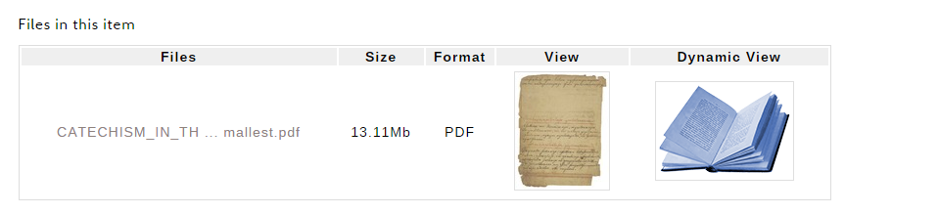
Solution 1
Add “Book View” Option for PDF Bitstreams

Slide 6
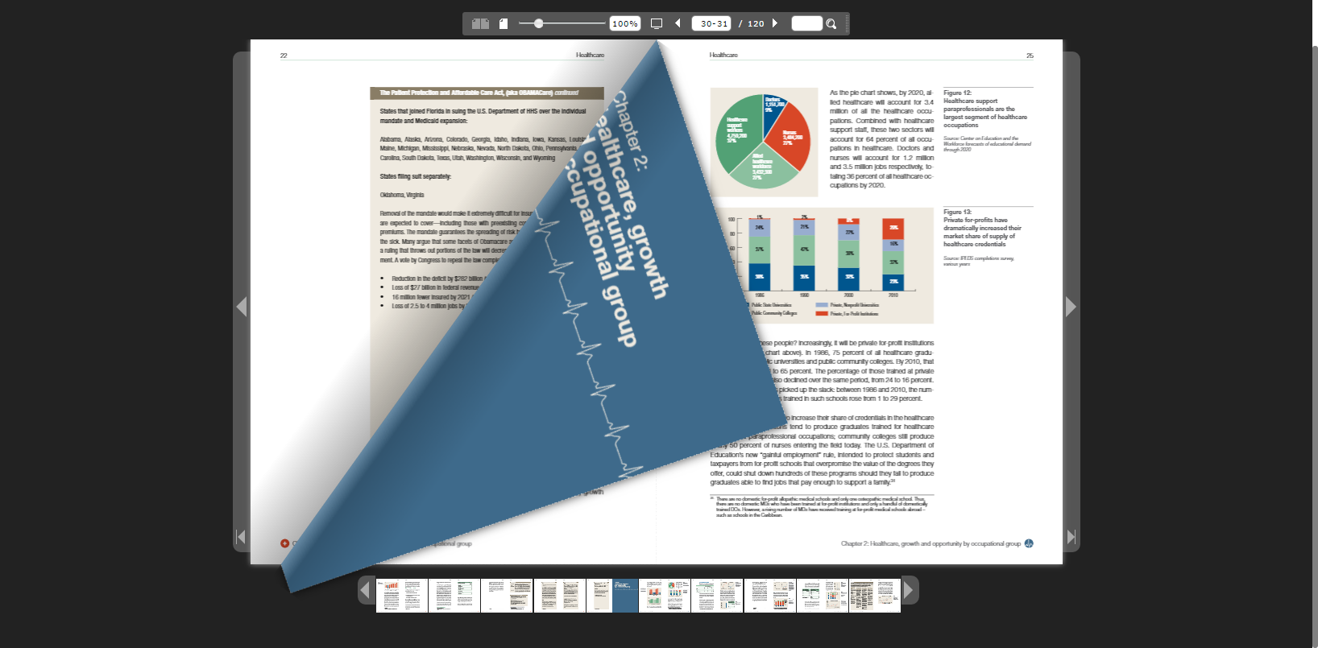

Slide 7
JavaScript rendering
Invoke Viewer
$('#documentViewer').FlexPaperViewer(
{ config : {
PDFFile : loc,
RenderingOrder : 'html5',
key : '<<License key goes here>>',
}}
);
Path to PDF
HTML5 Viewer
License Key

Slide 8
Initial Results
Beautiful display
Easy integration
PDF is accessed from DSpace
Embargo/restrictions honored

Slide 9

Challenge 1: Large file download

Slide 10
Solution 2: Pre-compile high-demand materials
Viewer assets loaded page by page
Create pre-compile folder
pdftk - break pdf into one page pdf’s
convert - convert each pdf page into thumbnail
pdf2json - extract search terms
sed - generate static index.html

Slide 11
Pre-compiled Asset Storage
Assets needed to reside in one directory
assetstore could not be used.
Assets served up by Apache, not tomcat
No awareness of item/bitstream restrictions
By policy, PDF’s under embargo could not be pre-compiled.

Slide 12
Reference pre-compiled assets
$('#documentViewer').FlexPaperViewer(
{ config : {
JSONFile : '/bookview/HANDLESEQ/link.pdf_{page}.js',
PDFFile : '/bookview/HANDLESEQ/link_[*,2].pdf',
ThumbIMGFiles : '/bookview/HANDLESEQ/link-{page}.jpg',
RenderingOrder : 'html5',
key : '<<License key goes here>>',
}}
);
Pre-compiled
Assets
HTML5 Viewer
License Key

Slide 13
Challenge 2: Inconsistent Page Orientation
Flexpaper HTML5 viewer normalizes page dimensions

Slide 14
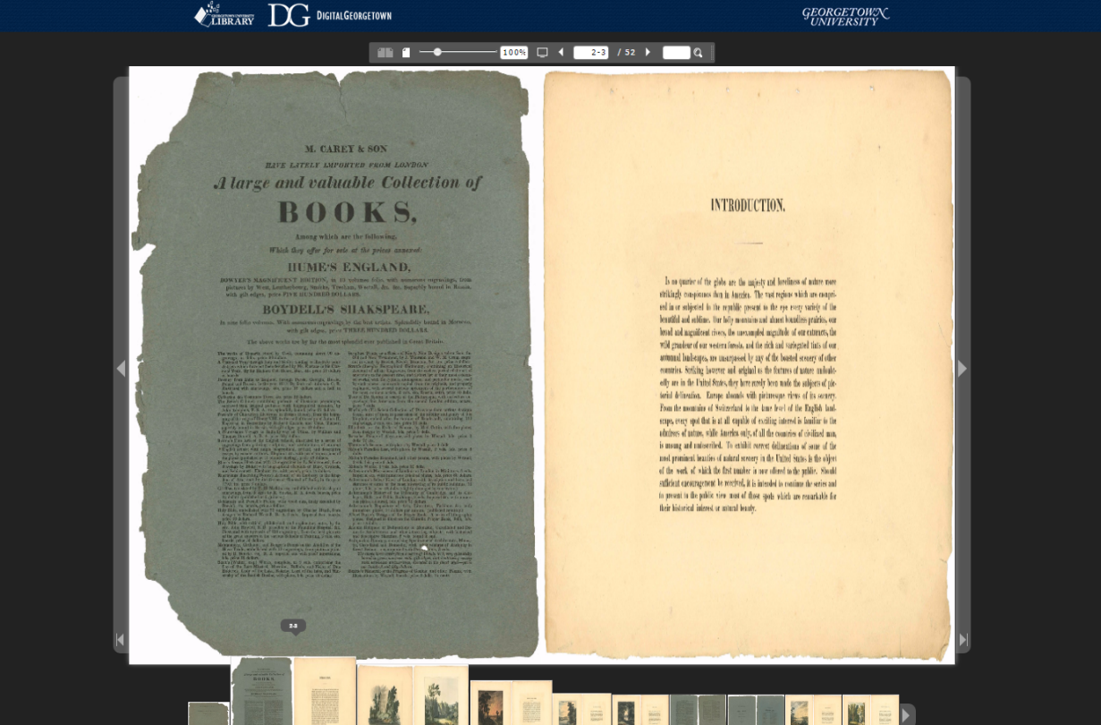

Slide 15
Solution 3: Compile irregular page orientation materials on desktop
Flash-based desktop viewer
Built a tool to identify mixed-orientation PDF’s

Slide 16
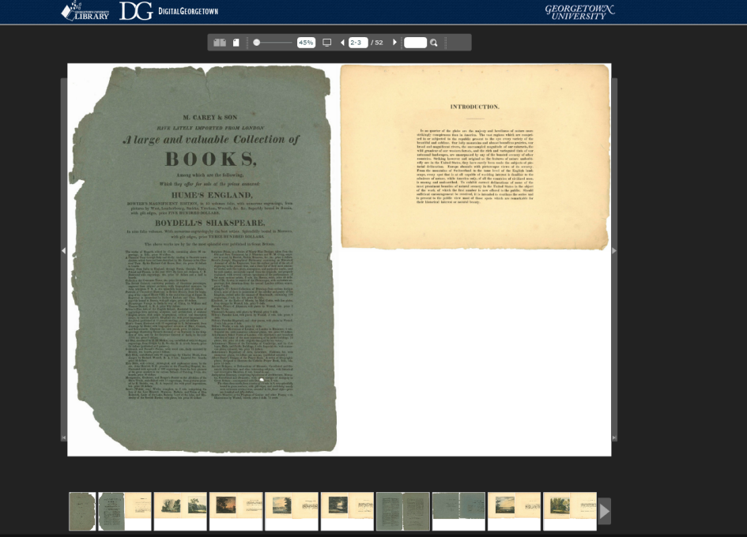

Slide 17
Problem 3: Irregular page sizes
Digitized material containing page fragments

Slide 18
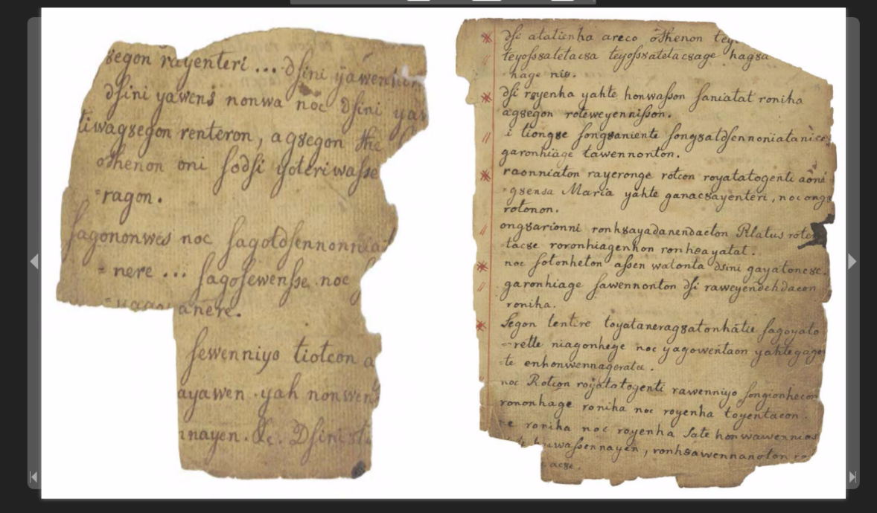

Slide 19
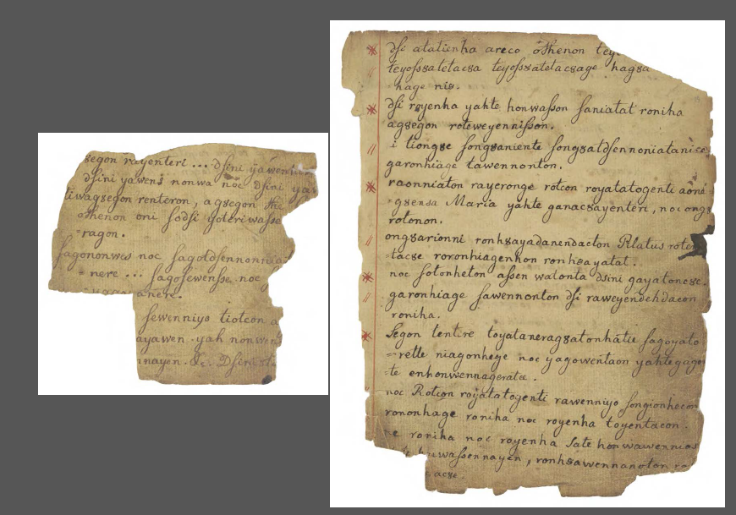
Actual Page Sizes

Slide 20
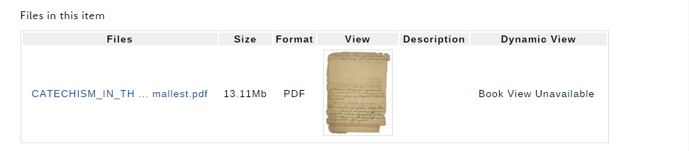
Solution 4: Turn off viewer for irregular page size items

Slide 21
Results
Beautiful viewer
Easy to integrate
Imperfect Solution
More exceptions than expected

Slide 22
Lessons learned
Use cases are more complicated than expected
Often in the assets that are most desirable to see in a viewer
We should have pre-processed every asset before production deployment

Slide 23
Plans for the future
Need to think bigger
Explore IIIF based viewer solutions
Derivative resources will reside on image server

Slide 24
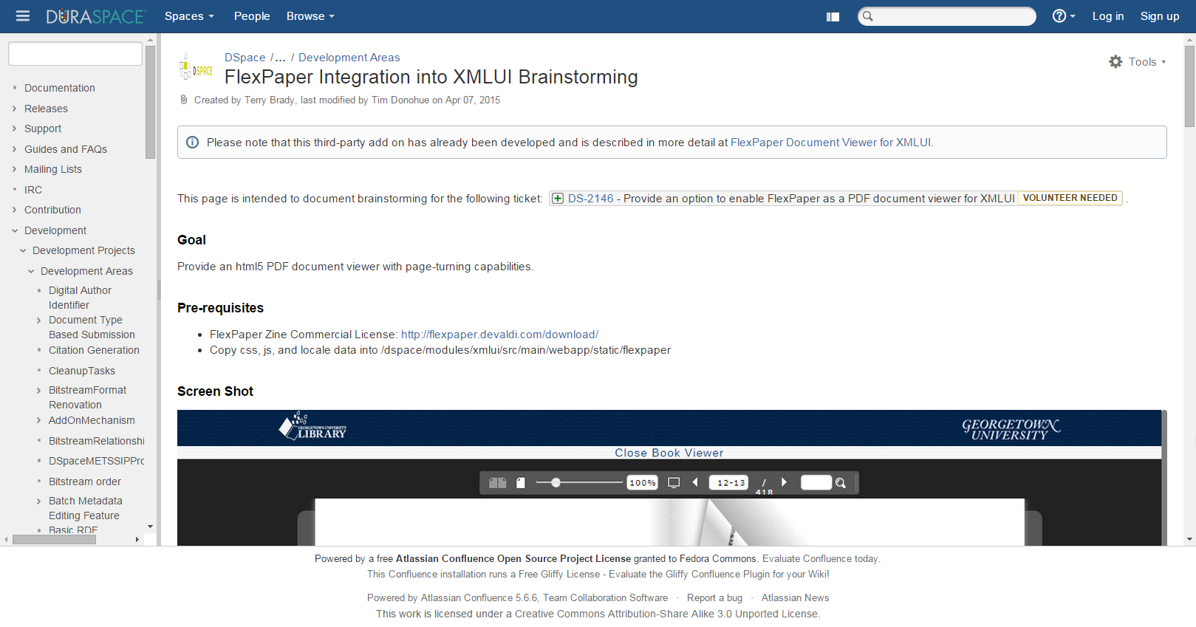
DSpace Wiki Page: FlexPaper Document Viewer for XMLUI

Slide 25
Terry Brady
Georgetown University Library
terry.brady@georgetown.edu
https://github.com/terrywbrady/info

